Slide 1
Convolutional AutoEncoders
Улучшение тепловизионного изображения малой размерности
Aleksandr Shirokov

Slide 2
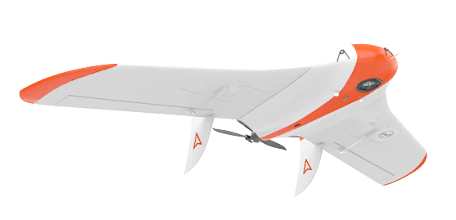
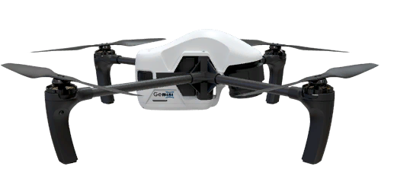
GeoScan
Aleksandr Shirokov

Slide 3
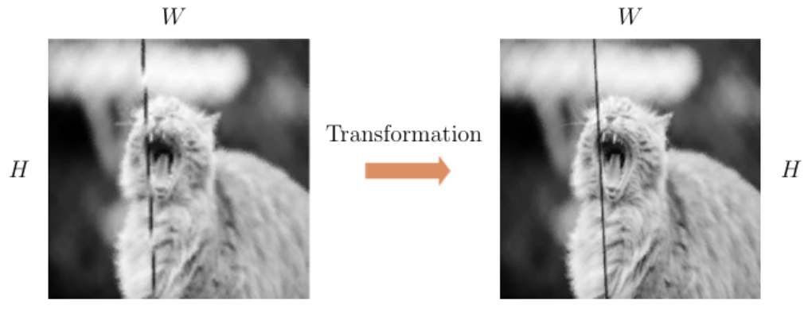

Image-to-Image
Aleksandr Shirokov

Slide 4
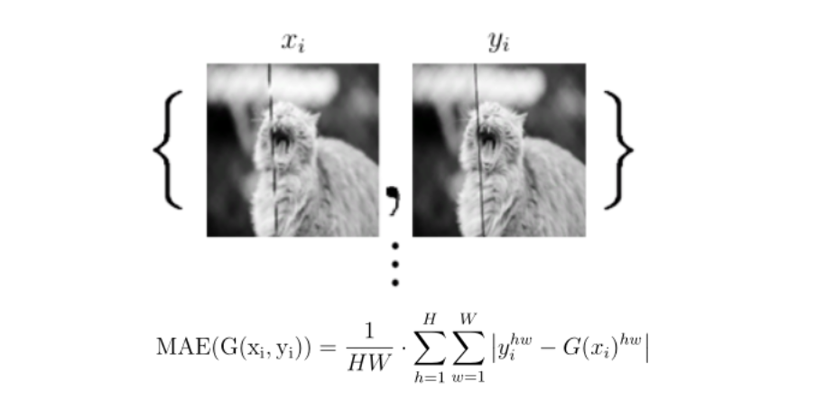
Loss function
Aleksandr Shirokov

Slide 5
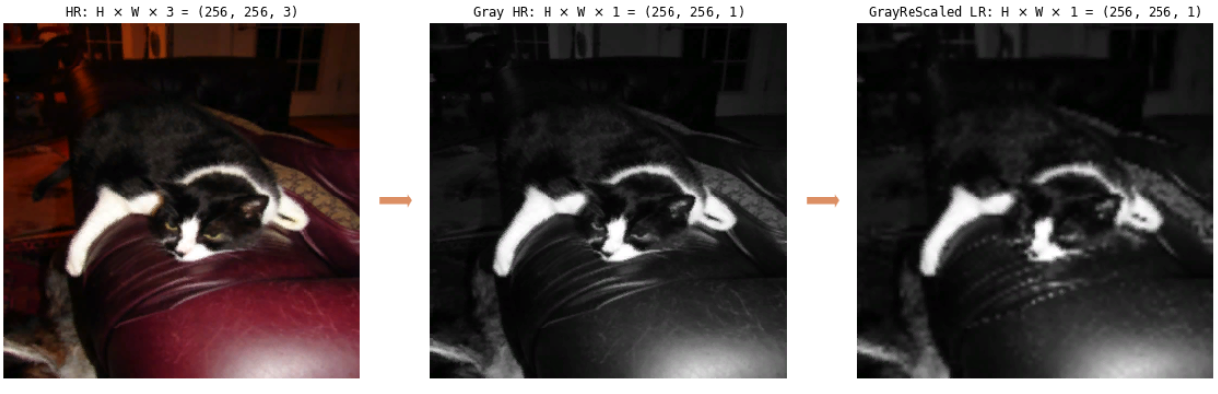
Dataset Preprocessing
High Resolution RGB -> Grayscale High Resolution -> Resized Low Resolution
ImageNet
Aleksandr Shirokov

Slide 6
Convolutional Neural Networks: Architecture
Aleksandr Shirokov

Slide 7
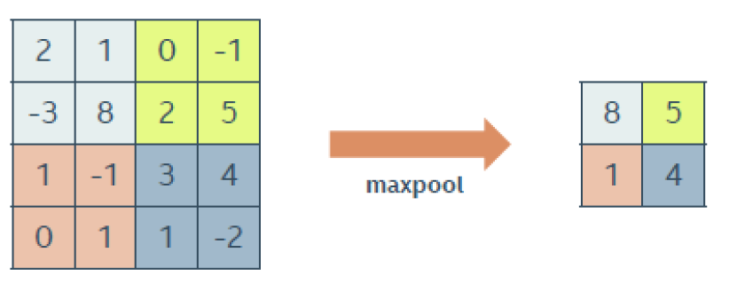
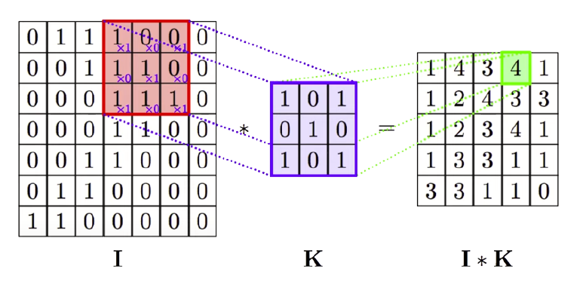

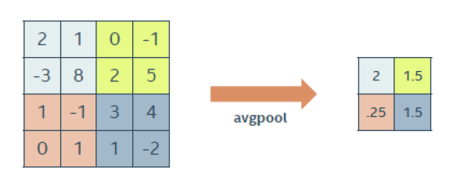

Convolutional Neural Networks: Decreasing Dimension
Aleksandr Shirokov

Slide 8
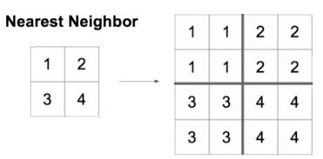
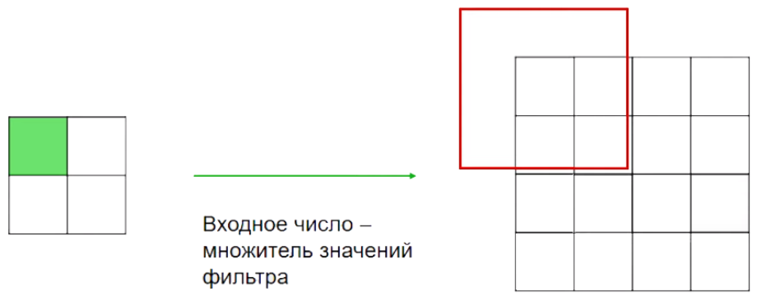
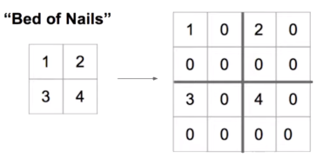
Convolutional Neural Networks: Increasing Dimension
UpScaling2D
Transpose Convolutional Layer
Aleksandr Shirokov

Slide 9
AutoEncoders: Architecture
Encoder
Decoder
Loss Function – MAE(MSE)
Aleksandr Shirokov

Slide 10
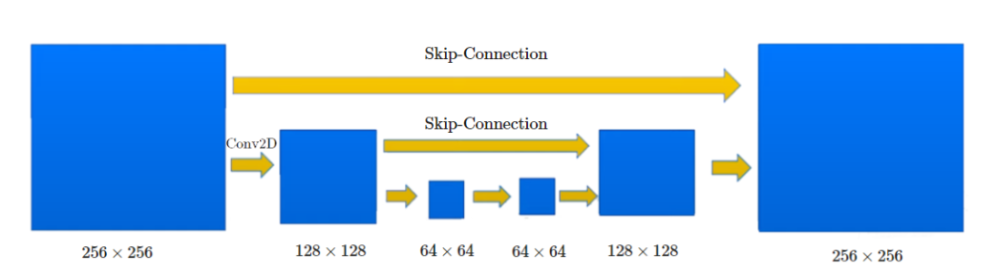
AutoEncoders: Improved! (Unet)
Aleksandr Shirokov

Slide 11
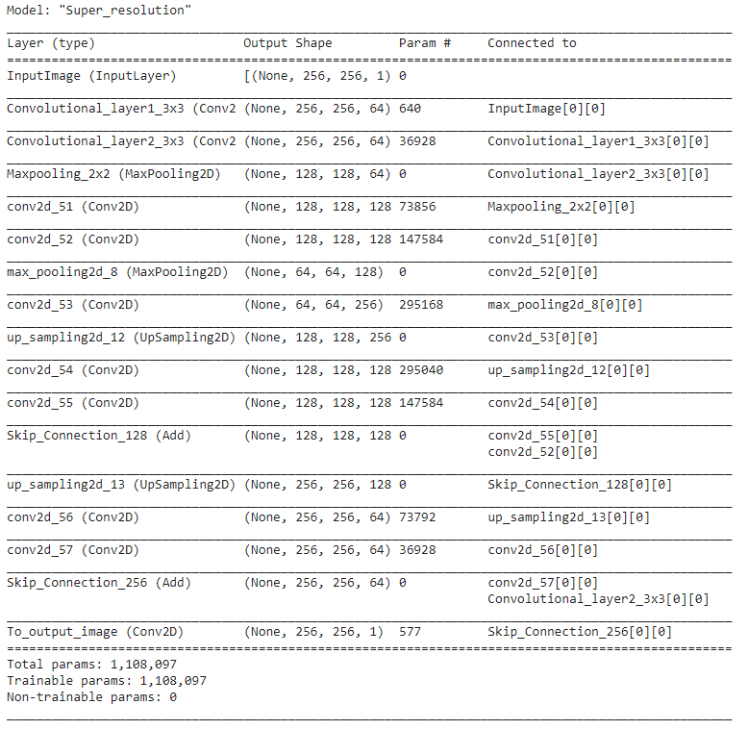
Keras: Architecture
Aleksandr Shirokov

Slide 12
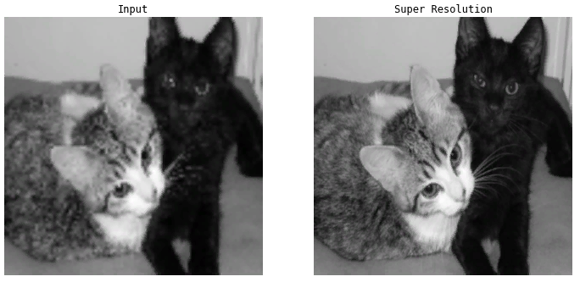
Results: Trained on Cats, Good!
Aleksandr Shirokov

Slide 13
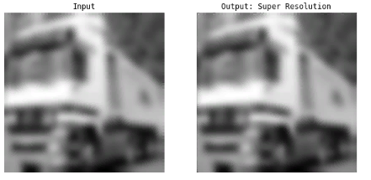
Results: cars… ??
Aleksandr Shirokov

Slide 14
Pros
Top-10 Kaggle With AutoEncoder Model
Visualisation
Introduction to CNN
Minuses
GAN’s
GPU
Overfitting
No real dataset
Aleksandr Shirokov

Slide 15
End
Aleksandr Shirokov

